Slide 1
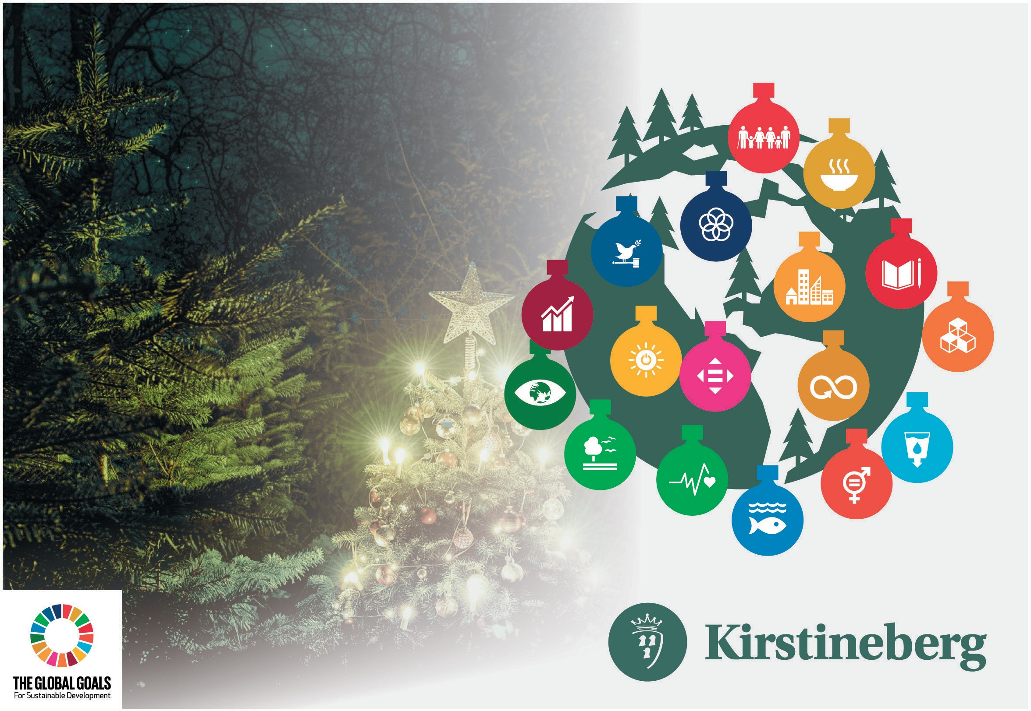
Kirstineberg act upon the UN sustainable development goals
We take sustainability seriously

Slide 2
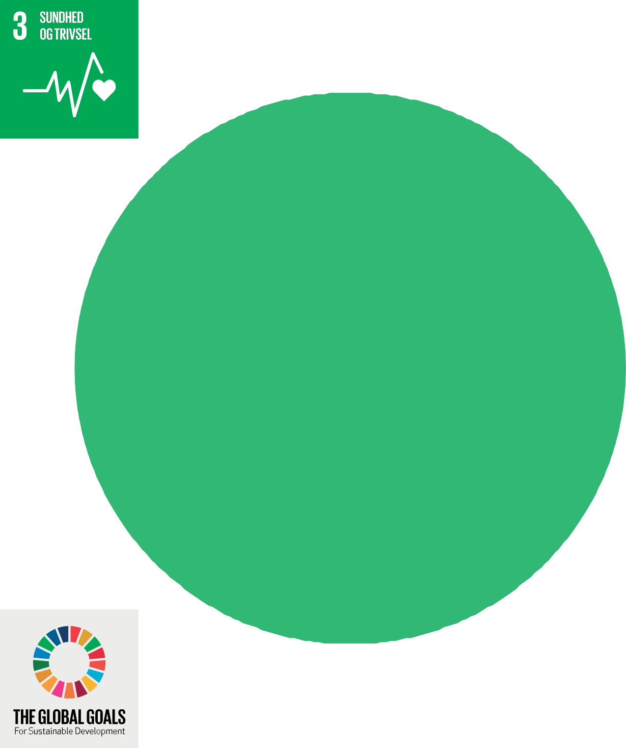

Heath and well-being.
Ensure a healthy life for all and promote health for all ages
We have regular meetings with our staff, to ensure well-being, and individual conversations. There is access to a crisis psychologist
We take sustainability seriously

Slide 3
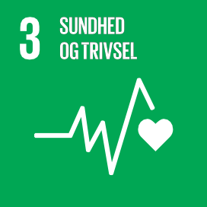
Health and well being
FN’S 17 World goals for sustainable growth
3: Health and well being.
Ensure a healthy life for all and improve well being for all ages.
3.8 Universal health coverage must be achieved, including protection against financial risks, access to vital information of high quality and access to safe and vital quality medicine and vaccines to an affordable price for all.
At Kirstineberg: We have regularly personal meetings, to ensure well being and individual conversations. There are access to crisis psychologist.
At Kirstineberg: This is covered by the danish community. We encourages all our employees to have an annual medical consultation.
3.6 Before 2030 the amount of global death and injuries as a result of traffic accidents are halved.
3.9 Before 2030 the number of death and illnesses as a cause by exposure of hazardous chemicals as well as air, water and soil pollution and contamination, significantly reduced.
At Kirstineberg: In our corporate policy ensures that all employees have the relevant driving licenses, as well as a zero tolerance for alcohol during working hours – or that one is affected at work.
At Kirstineberg: Our company is certified in Global GAP and MPS. We have the statutory workplace assessments APV, for example how to relate to chemicals and use of protective equipment. Our company policy is that no employee may be injured or injured by the use of fertilizers or chemicals.
3.7 Before 2030 there shall be secured an universal access to sexual and reproductive health services, hereby family planning, information and education, and integration of reproductive health in national strategies and program.
At Kirstineberg: The company has a pregnancy policy in accordance with the applicable agreements.
We take sustainability seriously

Slide 4
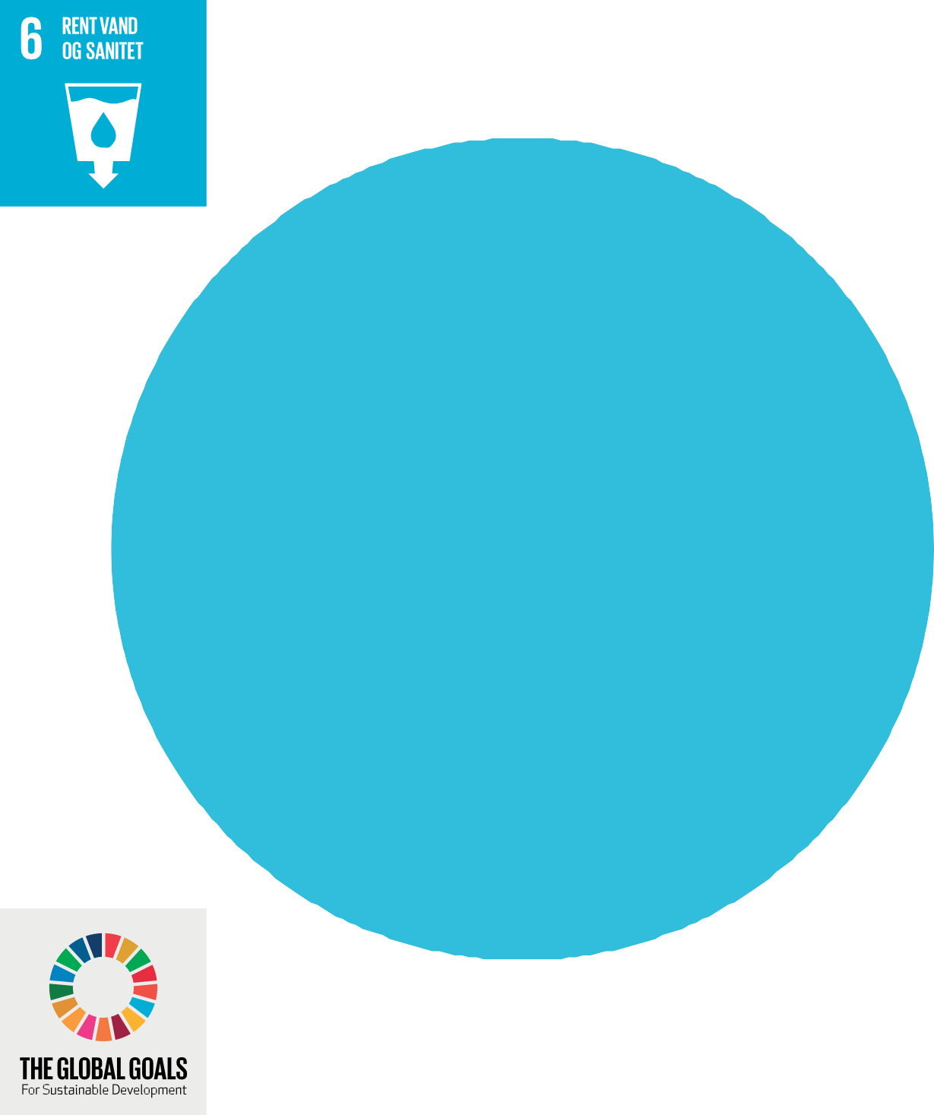
Clear water and sanity.
Before 2030, the water quality will be improved by reducing pollution, abolish waste dumping and minimize the dumping of dangerous chemicals and materials, and by halving the proportion of untreated wastewater and significantly increasing recycling and safe recycling globally.
We take sustainability seriously

Slide 5
Clean water and sanity
FN’S 17 World goals for sustainable growth
6.3 Before 2030 the quality of water must be improved by reducing pollution, abolish waste dumping and minimize emissions of hazardous chemicals and materials, and by halving the shares of untreated wastewater and significantly increase recycling and safe recycling globally.
6.4 By 2030 the efficiency of water consumption by all sectors significantly increases. And sustainable collection and supply of fresh water must be ensured to meet water scarcity and to reduce the number of people suffering from water shortages.
At Kirstineberg: Through our certification, we have a written procedure for handling all types of waste so that it is handled environmentally optimally and thereby leaves the company no negative imprint. We focus on rewaste disposal, if possible. Waste from the company is handled at public/ professional companies.
At Kirstineberg: Ensured through drip irrigation and collection of surplus water – we do not loose water unnecessary.
We take sustainability seriously

Slide 6
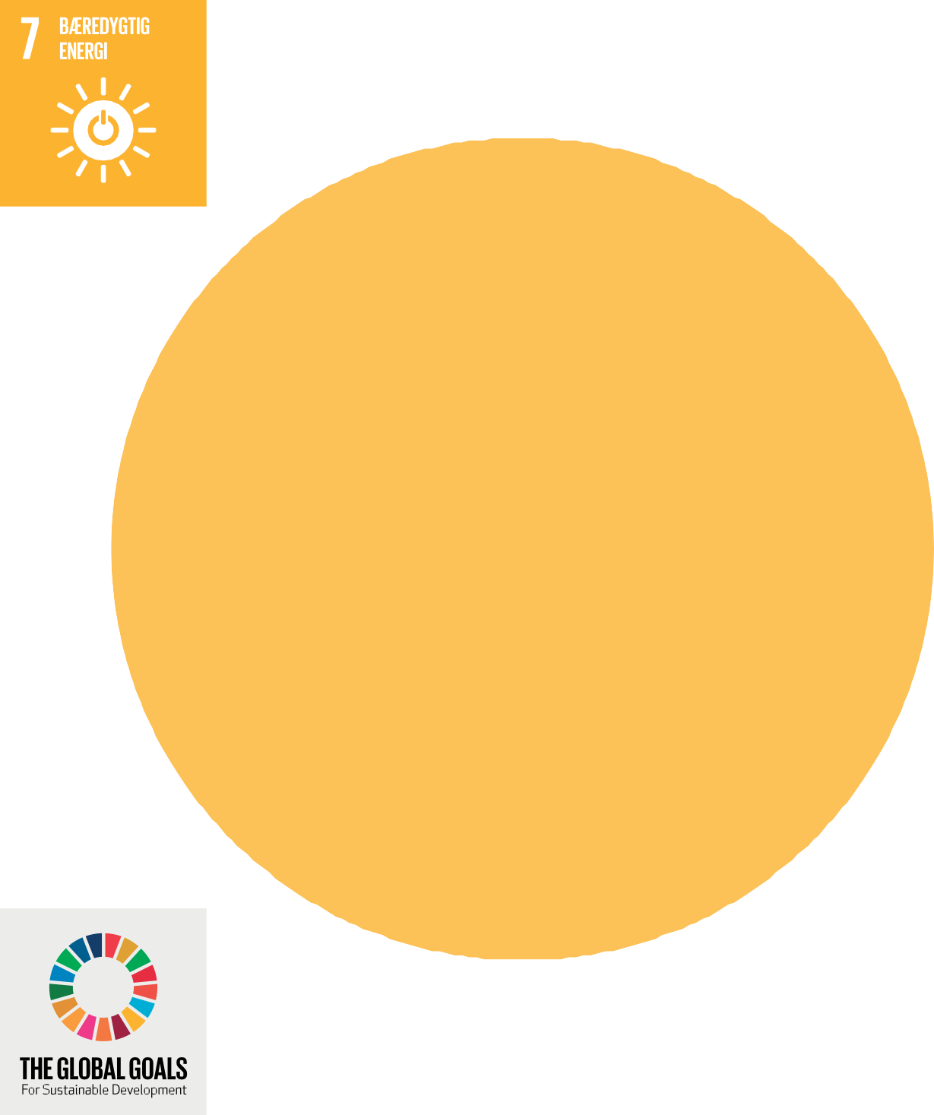
Sustainable energy.
Within 2030, the global speed for improving energy efficiency must be doubled.
We water more during the night. We will use green energy.
We introduces ongoing energy saving measures everywhere.
We take sustainability seriously

Slide 7
Sustainable energy
UN 17 WORLD GOALS FOR SUSTAINABLE DEVELOPMENT
UN`S 17 world goals for sustainable development
7.3 before 2030 the improvement of energy efficiency of global speed dobles.
At Kirstineberg: We will water more throughout the night. We will use green energy. We introduces ongoing water energy saving measures everywhere.
We take sustainability seriously

Slide 8
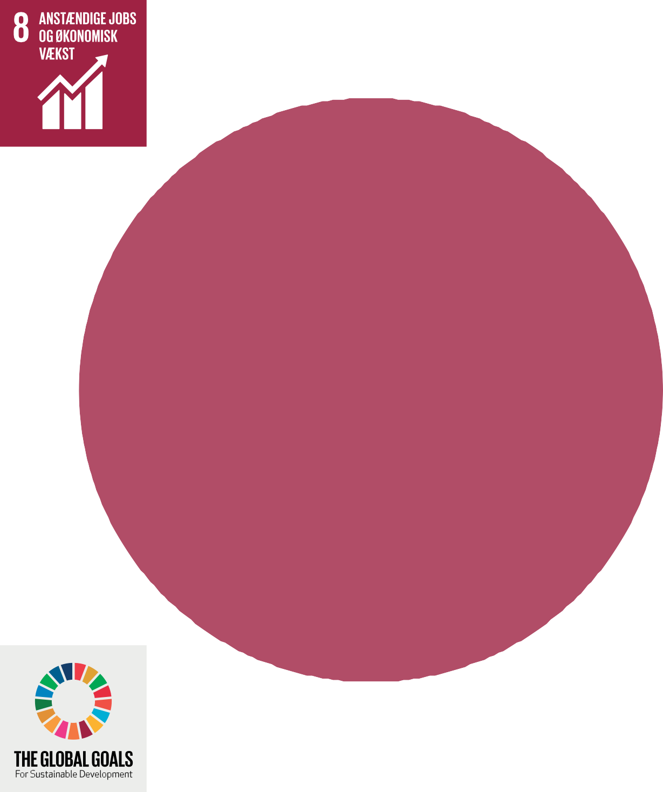
Decent jobs and economic growth.
Higher economic growth must be achieved through diversification, technological upgrading and diversification, among other things through a focus on high value added and labour intensive sectors.
We take sustainability seriously

Slide 9
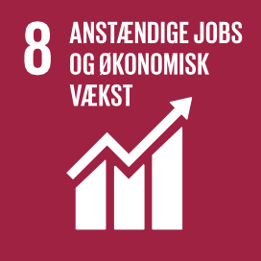
Decent jobs and economic growth
UN`S 17 World goals for sustainable development
8.2 Higher economic productivity must be achieved through diversification, technology, upgrading and innovation, among other things through a focus on high value added and labour intensive sectors.
At Kirstineberg: We are a competitive exposed company and also a labour intensive company. Therefore, we implements continuously innovate processes, that increase productivity and reduces the burden on the individual employee.
Spagnum must not come from protected areas and the bog must be able regenerate. Therefore sphagnum must not come from nature reserves and the bog must be able to regenerate.
The net used to pack the Christmas trees is made of recycled plastic, as well as the pots. We reuses all pot up to 15years.
Fertilizers must not be lost, therefore excess water and fertilizers are collected from the production and recycled in our special production system.
A cloth, called a weed cloth, which prevent weeds between the plants, and thus, pesticide consumption is greatly reduced.
Suppliers of small plants are certified.
8.4 Gradually improve global resource utilization until 2030 in consumption and production, and try to decouple economic growth from environmental degradation, in accordance with the 10-year Framework for Sustainable Consumption and Production , with the developed countries at the forefront.
Hos Kirstineberg:
8.6 Before 2020, the proportion of young people who are not in employment or education must be significantly reduced.
At Kirstineberg: We wish to contribute to the development of the youth, therefore we take practicians in.
8.8 The rights of workers must be protected and a safe and stable working environment for all workers must be promoted, including for migrant workers, especially for female migrants and those in precarious employment.
At Kirstineberg: The company is a member of an employers´ organisation, which is why the company is subject to the applicable collective agreement in the relevant subject areas, including danish working environment association.
As a business is an untapped resource but consumed in any way undesired – it affects both the environment and the companies results negative.
We focus on all factors of production – that they do not have a long lasting negative imprint on the environment, climate biodiversity etc.
Our company is certified with two ores virksomhed er certificeret i to environmental certification systems.
We take sustainability seriously

Slide 10
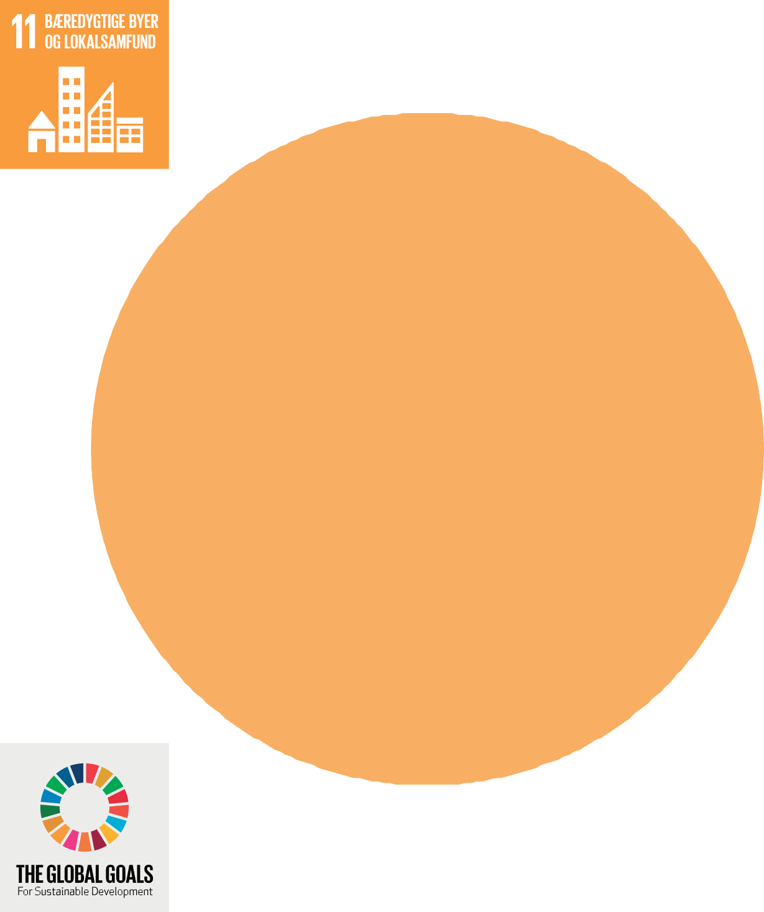
Strengthen efforts to protect and preserve the world´s cultural and natural heritage.
The companies Main Building and Tiendeladen is built in 1770 and is protected. They represent a part of the local cultural heritage and Denmark´s history, through the company´s return it contributes to maintain this cultural heritage.
We take sustainability seriously

Slide 11
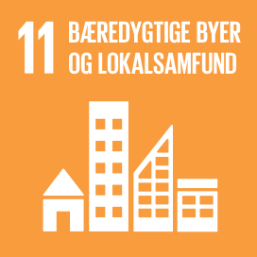
Sustainable cities and communities
UN`S 17 WORLD GOALS FOR SUSTAINABLE DEVELOPMENT
11.4 Strengthen efforts to protect and preserve the world´s cultural and natural heritage.
At Kirstineberg: the company´s Main building and Tiendeladen is built in 1770 and protected. They represent a part og the local danish history through the company´s return and contributes to maintaining the cultural heritage.
11.6 Before 2030 the negative environmental return per person be reduced, herby to emphasis on air quality and on municipal and other waste management.
At Kirstineberg: Our pot grown Christmas trees can
help to clean the air in the cities and after Christmas they can either be used as a decoration in the pot on the balcony, at the entrance at the front garden or planted out in the garden, parks, forest etc. Thus continuing to contribute to air purification and sequestrations of CO2.
We take sustainability seriously

Slide 12
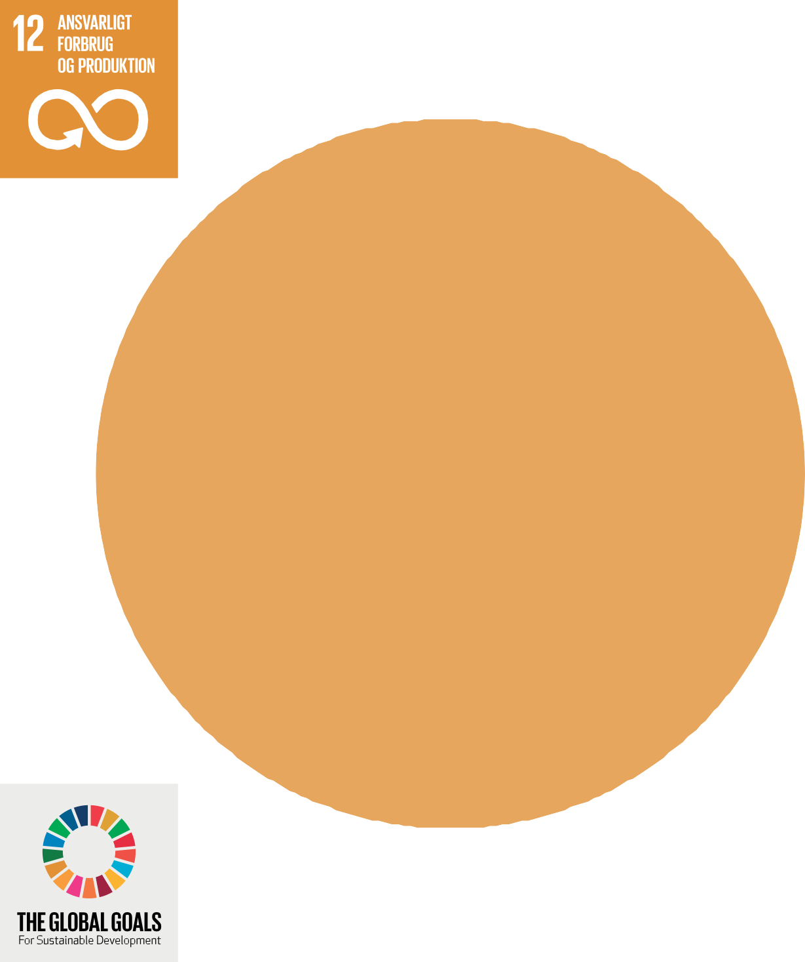
Responsible consumption
and production
We focus on recycling waste, returning it to the value chain, and we buy recycled auxiliary assets wherever possible.
It is part of the company's strategy that all processes and inputs must be made more sustainable on an ongoing basis. Therefore, the goal is that we continuously move and think more sustainability into all actions and processes
Sustainability in all our processes

Slide 13
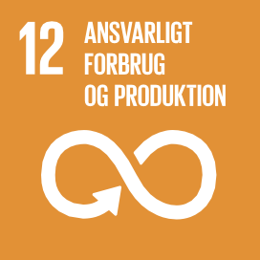
Responsible consumption and production
UN`S 17 WORLD GOALS FOR SUSTAINABLE DEVELOPMENT
12.4 Before 2020 environmentally sound management of chemicals and waste must be achieved through out their life cycle, in accordance with the agreed international framework conditions, and their emission to air, water and soil must be significantly reduced in order to reduce their negative effects on human health and the environment.
At Kirstineberg:
At Kirstineberg: We have focus on to reuse waste, return it to the value chain and we buy recycled aids where it is possible.
12.6 Encourage companies, especially large and transnational companies, to work sustainably and to integrate sustainability information into their reporting cycle.
At Kirstineberg: It is a part of the company´s strategy that all processes and inputs must be made more sustainable on an ongoing basis. Therefore, there is a goal that we continuously move and think more sustainability into all actions and processes. IT is both common sense and good business, as it is ultimately about how to use the resources.
The company is certified with Global Gap and MPS, where there is a focus on the environment, resource use and the working environment.
As a company, an unused resource, but a consumed resource is in any way undesirable – it has a negative effect on both the environment and the company´s result.
We focus on the fact that not all factors of production have a long term negative impact on the environment, climate and biodiversity..
Sphagnum must not come from protected areas – and the bog must be able to regenerate
The net in which the trees are packed is made of recycled plastic.
The pots are made of recycled plastic.
We reuses the small pots up to 15 years.
Fertilizers must not be lost, therefore excess water and fertilizers from the production are collected in our specially designed production systems.
A cloth is laid, called a weed cloth, which means that no weeds come between the plants and thus, the pesticide consumption is greatly reduced..
12.8 By 2030 it must be ensured that people everywhere have the relevant information and knowledge about sustainable development and lifestyle in harmony with nature.
At Kirstineberg:
Our contribution here is that we produce a potted Christmas tree that can be planted out after Christmas. The Wood will subsequently bind CO2 and at some point this wood can be used for furniture/ building materials etc., whereby CO2 is made and thus bound for many years.
In our production we borrow from nature, we wish to use as lilted as possible.
12.5 By 2030 the amount of waste must be significantly reduced through, reduction and recycling.
We take sustainability seriously

Slide 14
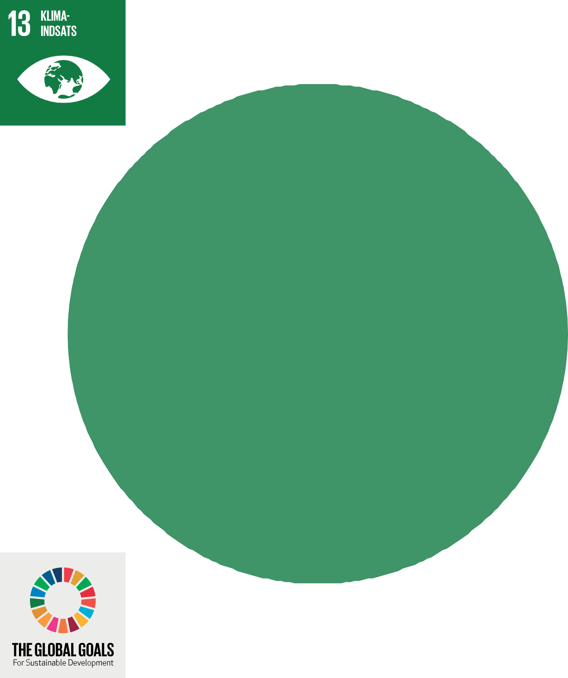
Strengthen resilience and adaptability to climate-related risks and natural disasters in all countries.
At Kirstineberg: Our contribution is that we produce a pot-grown Christmas tree, which can be planted outside after Christmas - the tree will continue to bind CO2.
Sustainability in all our processes

Slide 15
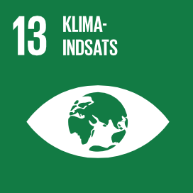
Climate action
UN`S 17 WORLD GOALS FOR SUSTAINABLE DEVELOPMENT
13.1 Strengthen resilience and adaptability to climate related risks and natural disasters in all countries.
13.1 Strengthen resilience and adaptability to climate related risks and natural disasters in all countries.
At Kirstineberg: Our contribution is that we can grow a pot grown Christmas tree which can be planted out after Christmases. The tree will subsequently by the continued growth bind CO2. At some point this tree can be used for furniture or building materials whereby CO2 in bounded for many years. We have a product here where you can store CO2 for an infinite number of years.
At KKirstineberg: As our wood can bind CO2, it must help reduce climate change. In our company, we have established wind breaks, which reduces a number of climate related risks in production but at the same time they can help to clean the air.
We take sustainability seriously

Slide 16
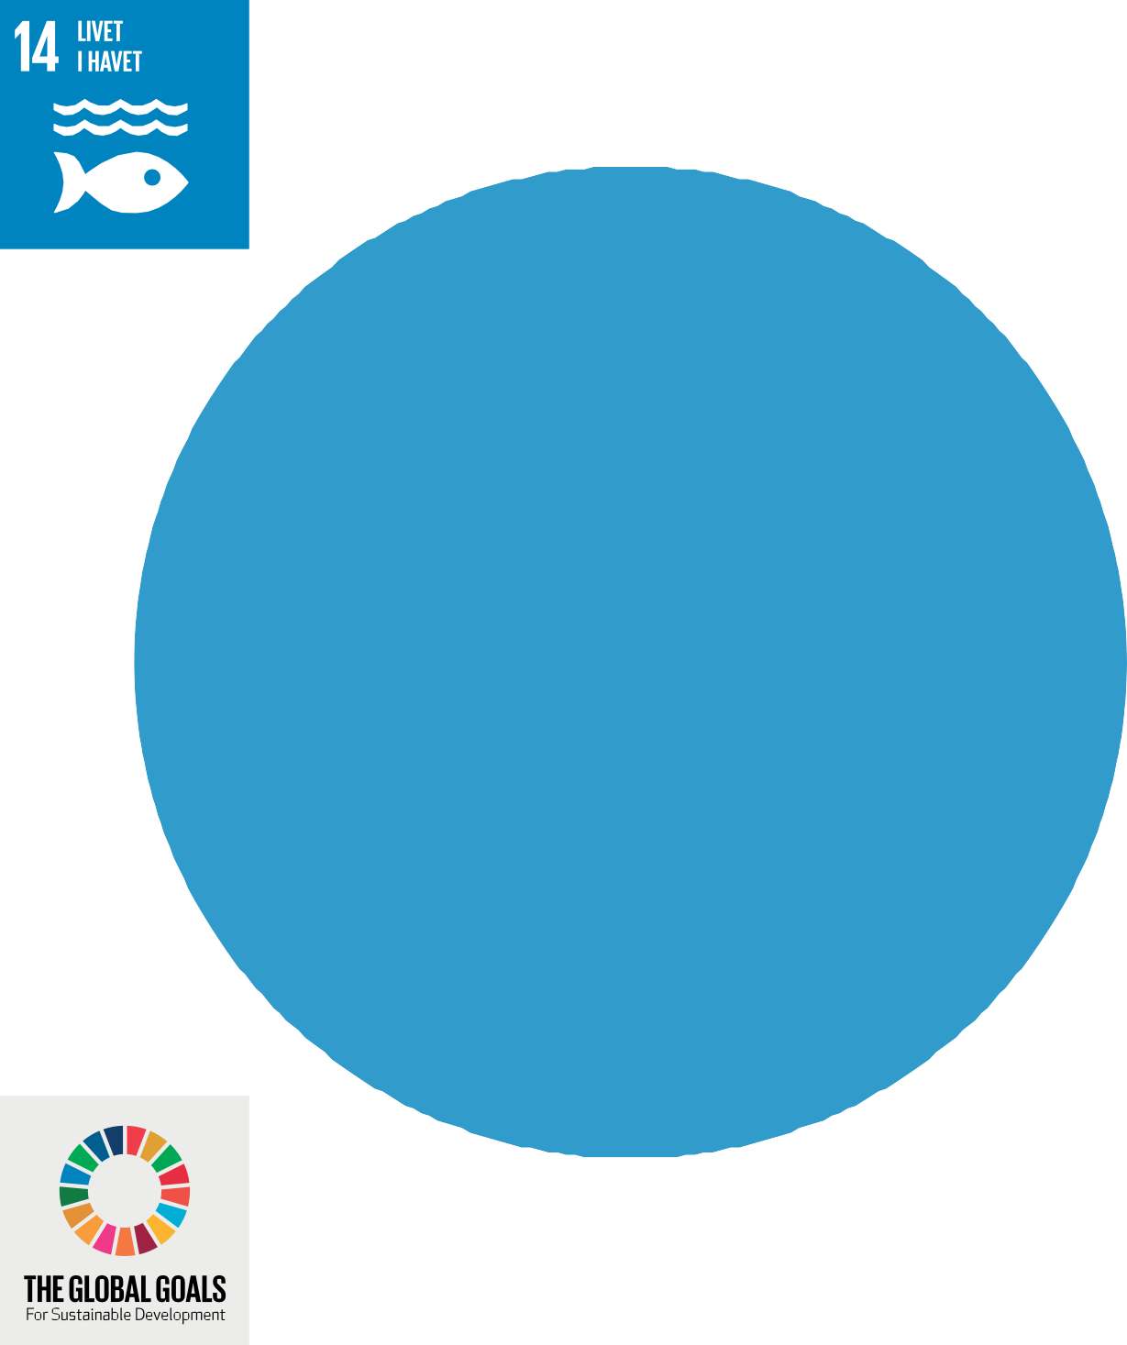
. By 2020, at least 10% of coastal and marine areas must be protected, in accordance with national and international law and based on it.
best available scientific information.
In our production system we do not lose nutrients and thus contribute to the fulfillment of the EU Water Framework Directive.
Sustainability throughout our process

Slide 17
Life in the sea
UN`S 17 WORLD GOALS FOR SUSTAINABLE DEVELOPMENT
14.5 Before 2020, minimum 10% of the coastal and marine areas be protected, in accordance with national and international law and based on the best available scientific information.
At Kirstineberg: In our production system we do not loose vital nutrition's – and thus contribute to the achievement of the EU´s Water Frame Directive.
We take sustainability seriously

Slide 18
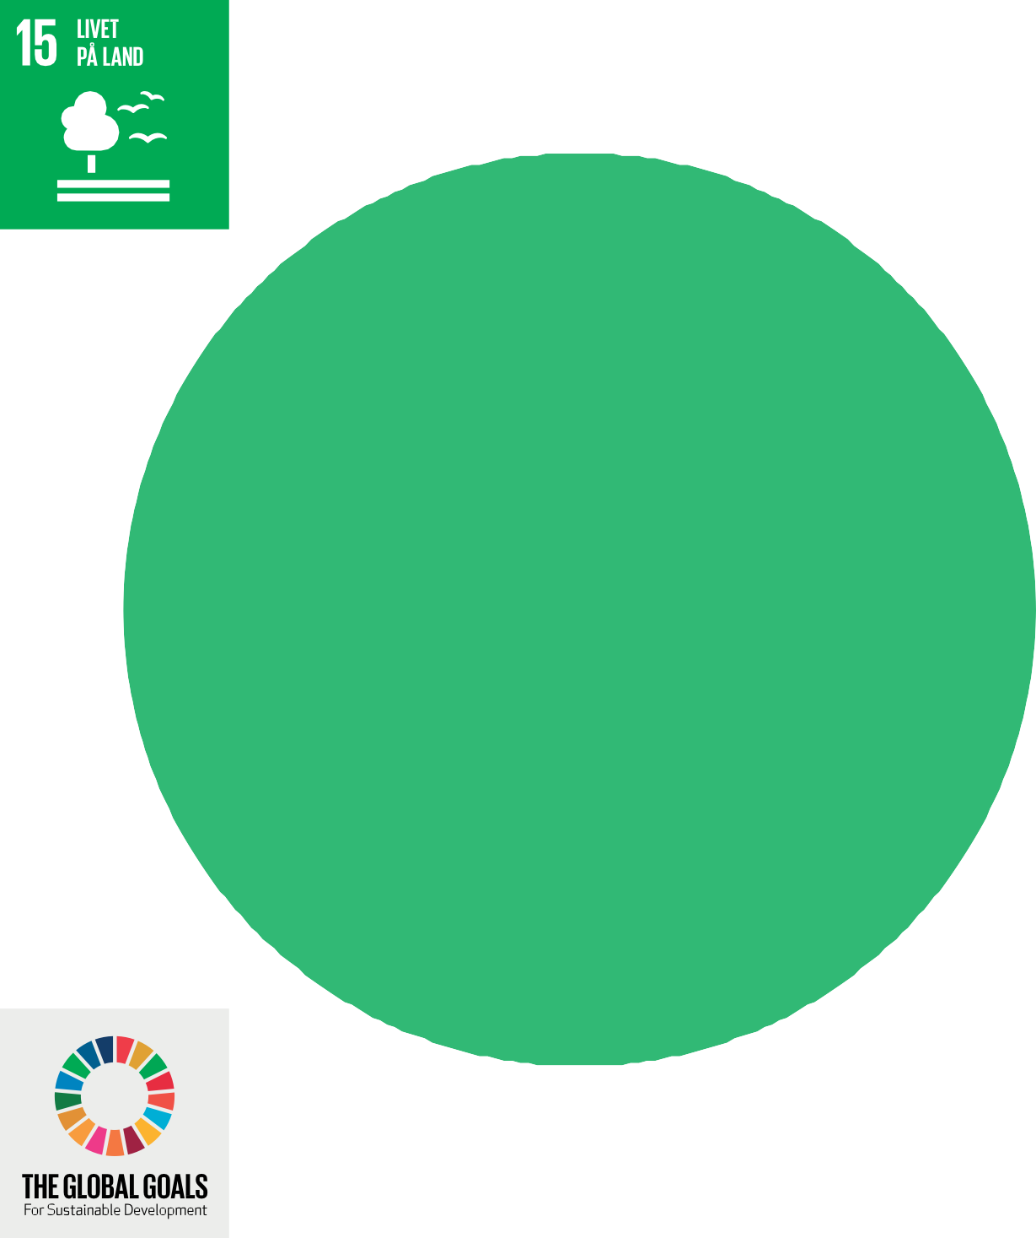
Life in the countryside
Through our Global Gap certification, we have policies for managing uncultivated areas. The company endeavors to the greatest possible extent to take into account the game and nature in the production.
Sustainability throughout our process

Slide 19
Life in the countryside
UN`S 17 WORLD GOALS FOR SUSTAINABLE DEVELOPMENT
Goal 15: Life in the countryside
Protect, restore and support sustainable use of terrestrial ecosystems, combat desertification, halt soil depletion and biodiversity loss.
This is done by doing following:
Nature is sought to be utilized so that nature does not disappear or deteriorate significantly. The utilization of the areas is based on moral and ethical ideas.
The field planning is sought to be carried out with the greatest possible consideration for the species associated with the open cultivated land, so that their chances of survival are ensured.
Uncultivated field corners, field boundaries, ditches, hedges, water holes, as well as soil and rock dikes are sought to be maintained as habitats for the fields animals and plants, and efforts are made to avoid excessive impacts from operations.
Windbreaks has been established and these are taken into account as much as possible in relation to the drift of pesticides.
At Kirstineberg: Through our Global Gap certification, we have policies of uncultivated areas. The company strives to, as far as possible, to take the greatest possible account of game and nature in connection with production.
Retention of wetlands
Birds and owl boxes are set up.
We protect habitats for plants and animals and seek to improve their conditions.V
We take sustainability seriously

Slide 20
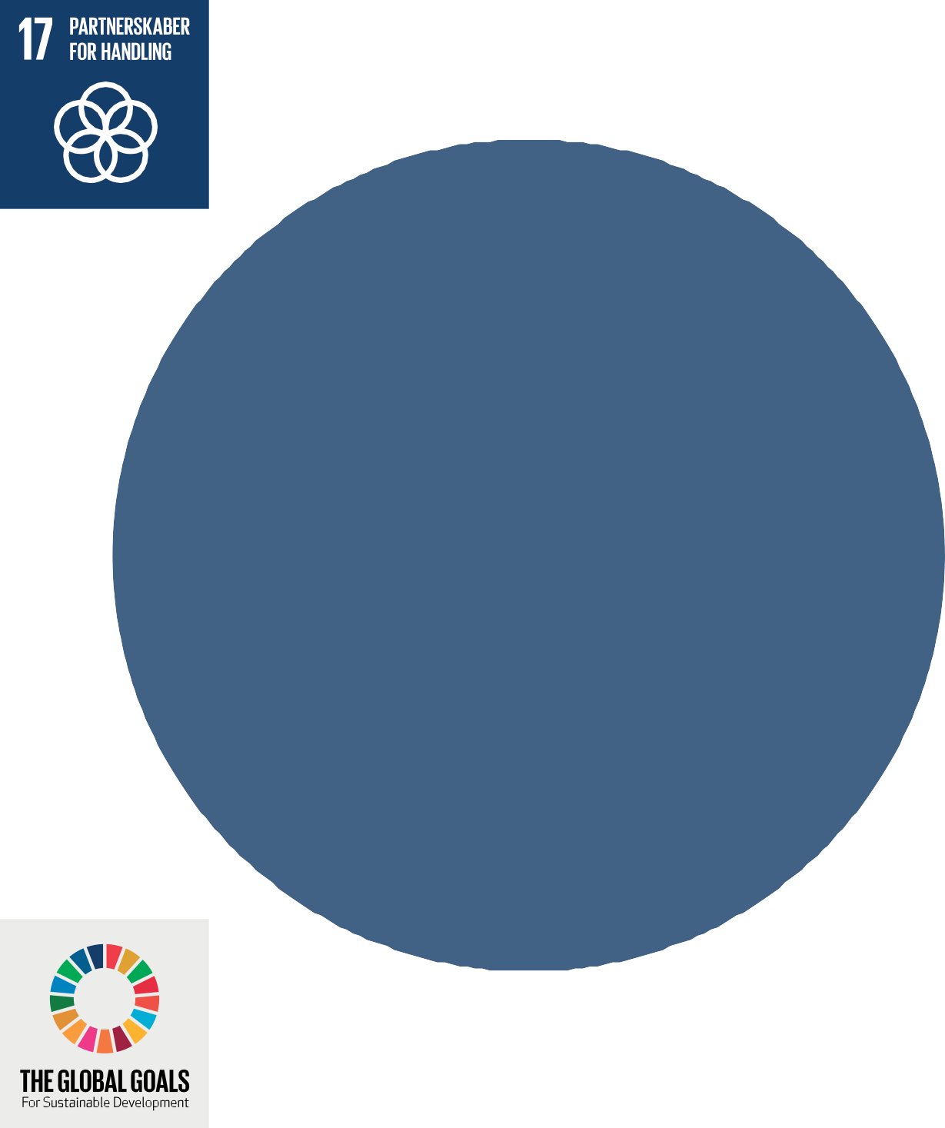
Partnership for Action Cultivate the Global Sustainable Development Partnership and Increase Funding to Achieve Goals.
The world goals for sustainable development can only be achieved
through strong global engagement and collaboration. At Kirstineberg we take that seriously
Sustainability throughout our process

Slide 21
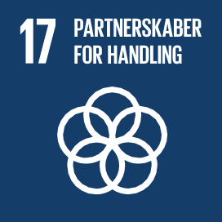
Partnership for action
UN`S 17 WORLD GOALS FOR SUSTAINABLE DEVELOPMENT
Goal 17: Partnership for action
Cultivate the global partnership for sustainable development and increase the means to achieve the goals
The global goals for sustainable development can only be achieved through strong global commitment and cooperation.
Christmas is the time were we strengthen partnerships.
We take sustainability seriously

